Slide 1
Chapter 18: Concurrency Control

Slide 2
Outline
Lock-Based Protocols
Timestamp-Based Protocols
Validation-Based Protocols
Multiple Granularity
Multiversion Schemes
Insert and Delete Operations
Concurrency in Index Structures

Slide 3
Lock-Based Protocols

Slide 4
Locking
A lock is a mechanism to control concurrent access to a data item
Data items can be locked in two modes :
1. exclusive (X) mode. Data item can be both read as well as
written. X-lock is requested using lock-X instruction.
2. shared (S) mode. Data item can only be read. S-lock is
requested using lock-S instruction.
Lock requests are made to concurrency-control manager. Transaction can proceed only after request is granted.

Slide 5
Lock Compatibility
Lock-compatibility matrix
A transaction may be granted a lock on an item if the requested lock is compatible with locks already held on the item by other transactions
Any number of transactions can hold shared locks on an item,
But if any transaction holds an exclusive on the item no other transaction may hold any lock on the item.
Notes:
If a lock cannot be granted, the requesting transaction is made to wait till all incompatible locks held by other transactions have been released. The lock is then granted.

Slide 6
Locking Example
Example of a transaction performing locking:
T₂: lock-S(A);
read (A);
unlock(A);
lock-S(B);
read (B);
unlock(B);
display(A+B)
Locking as above ensures that a data item is not modified by multiple transactions at the same time.
It is not, however, sufficient to guarantee serializability
To ensure serializability we need to use locking protocols

Slide 7
Locking Protocols
A locking protocol is a set of rules followed by all transactions while requesting and releasing locks.
Locking protocols enforce serializability by restricting the set of possible schedules.

Slide 8
The Two-Phase Locking Protocol (2PL)
A protocol which ensures conflict-serializable schedules.
Phase 1: Growing Phase
  Transaction may obtain locks
  Transaction may not release locks
Phase 2: Shrinking Phase
  Transaction may release locks
  Transaction may not obtain locks
The protocol assures serializability. It can be proved that the transactions can be serialized in the order of their lock points (i.e., the point where a transaction acquired its final lock).
Locks
Time

Slide 9
The Two-Phase Locking Protocol (Cont.)
Extensions to the basic two-phase locking are needed to ensure recoverability or freedom from cascading roll-back
  Strict two-phase locking: a transaction must hold all its exclusive locks till it commits/aborts.
    Ensures recoverability and avoids cascading roll-backs
  Rigorous two-phase locking: a transaction must hold all locks till commit/abort.
    Transactions can be serialized in the order in which they commit.
Most databases implement rigorous two-phase locking, but refer to it as simply two-phase locking

Slide 10
The Two-Phase Locking Protocol (Cont.)
Two-phase locking is not a necessary condition for serializability
  There are conflict serializable schedules that cannot be obtained if the two-phase locking protocol is used.
However, in the absence of extra information (e.g., ordering of access to data), two-phase locking is necessary for conflict serializability in the following sense:
  Given a transaction T_{i} that does not follow two-phase locking, we can find a transaction T_{j} that uses two-phase locking, and a schedule for T_{i} and T_{j} that is not conflict serializable.

Slide 11
Legal Schedules
Given a locking protocol (such as 2PL)
  A schedule S is legal under a locking protocol if it can be generated by a set of transactions that follow the protocol
  A protocol ensures serializability if all legal schedules under that protocol are serializable

Slide 12
Lock Conversions
Two-phase locking protocol with lock conversions:
– Growing Phase:
  Can acquire a lock-S on item
  Can acquire a lock-X on item
  Can convert a lock-S to a lock-X (upgrade)
– Shrinking Phase:
  Can release a lock-S
  Can release a lock-X
  Can convert a lock-X to a lock-S (downgrade)
This protocol ensures serializability

Slide 13
2PL Protocol Issues
Possibility of deadlocks (more on deadlocks later)
The 2PL locking protocol ensures serializability if the lock and unlock requests are issued correctly. However:
  A user my forget to issue requests all together
  A user may lock and forget to unlock
  A user my issue unlock-x(A) .. lock-x(A)
  A user my issue lock-x(A) .. lock-x(A)
  Etc.
If a transaction needs to lock many data items, the overhead is very costly. What should be the granularity of data items.?
    Relations
    Tuples
    Something else

Slide 14
Automatic Acquisition of Locks
The availability of lock conversion allow us to develop a scheme where the user is not required to issue the lock requests.
A transaction T_{i} issues the standard read/write instruction, without explicit locking calls.
The operation read(D) is processed as:
if T_{i} has a lock on D
then
read(D)
else begin
if necessary, wait until no other
transaction has a lock-X on D
grant T_{i} a lock-S on D;
read(D)
end

Slide 15
Automatic Acquisition of Locks (Cont.)
The operation write(D) is processed as:
if T_{i} has a lock-X on D
then
write(D)
else begin
if necessary, wait until no other trans. has any lock on D,
if T_{i} has a lock-S on D
then
upgrade lock on D to lock-X
else
grant T_{i} a lock-X on D
write(D)
end;
All locks are released after commit or abort

Slide 16
Implementation of Locking
A lock manager can be implemented as a separate process
Transactions can send lock and unlock requests as messages
The lock manager replies to a lock request by sending a lock grant messages (or a message asking the transaction to roll back, in case of a deadlock)
  The requesting transaction waits until its request is answered
The lock manager maintains an in-memory data-structure called a lock table to record granted locks and pending requests

Slide 17
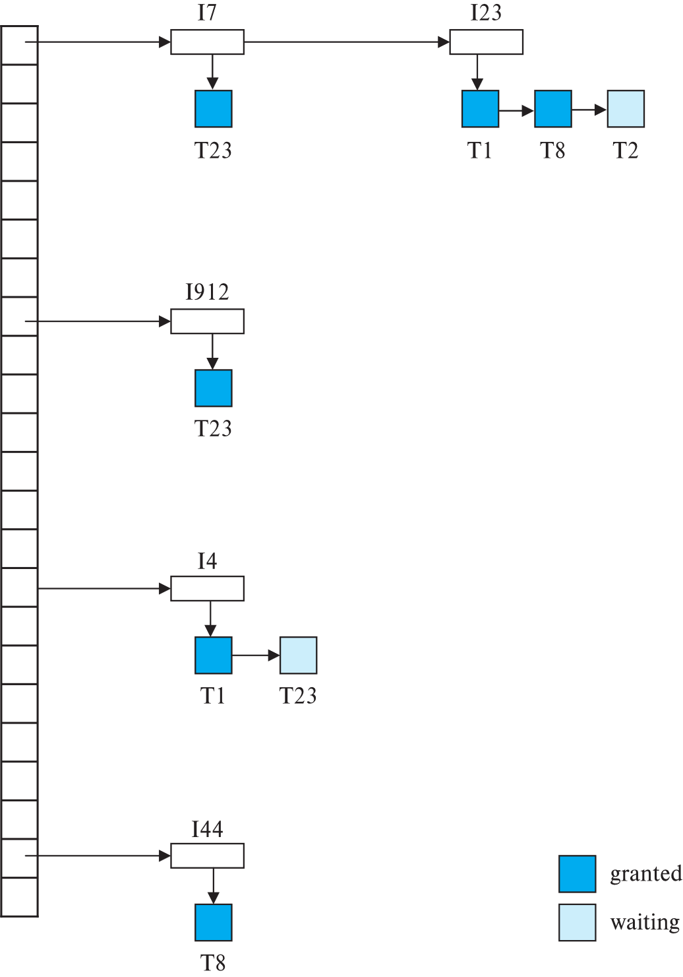
Lock Table
Data items I4, I7, I23, I44, I912
Dark rectangles indicate granted locks, light colored ones indicate waiting requests
Lock table also records the type of lock granted or requested
New request is added to the end of the queue of requests for the data item, and granted if it is compatible with all earlier locks
Unlock requests result in the request being deleted, and later requests are checked to see if they can now be granted
If transaction aborts, all waiting or granted requests of the transaction are deleted
  Lock manager may keep a list of locks held by each transaction, to implement this efficiently

